Slide 1

Noida Institute of Engineering and Technology, Greater Noida
Advance Java Programming(ACSAI0612)
Unit 1-JDBC and Servlet
Course Details ( B Tech 6th Sem)
Shweta Singh
Assistant Professor
CSE-AI

Slide 2
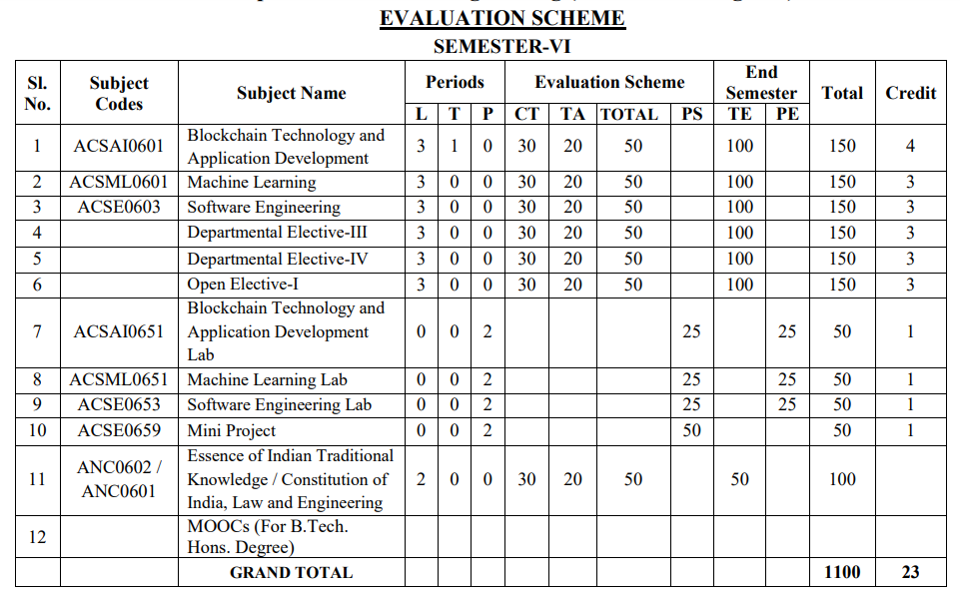
Evaluation Scheme

Slide 3
Syllabus Unit -1
JDBC: Introduction, JDBC Driver, DB Connectivity, Driver Manager, Connection, Statement, Result Set, Prepared Statement, Transaction Management, Stored Procedures.
Servlet: Servlet Overview, Servlet API, Servlet Interface, Generic Servlet, HTTP Servlet, Servlet Life Cycle, Redirect requests to other resources, Session Tracking, Event and Listener.

Slide 4
Syllabus Unit -2
JSP: Introduction, Overview, JSP Scriptlet Tag, JSP expression Tag, JSP declaration Tag, Life Cycle of JSP, JSP API, Implicit Objects: JSP request, JSP response, JSP config, JSP session, JSP Application, JSP PageContext; JSP Page, JSP Exception.

Slide 5
Syllabus Unit -3
Spring 5.0: Spring Core Introduction and Overview, Managing Beans, The Spring Container, The Factory Pattern, Dependency Injection (DI), Spring Managed Bean Lifecycle, Constructor Injection, Metadata/Configuration: Life Cycle Annotations, Java Configuration, XML Free configuration.

Slide 6
Syllabus Unit -4
Spring MVC: Introduction/Developing Web Application with Spring MVC, Advanced Techniques, Spring Controllers
Spring Boot: Spring Boot Starters, CLI, Application Class, Logging, Auto Configuration Classes, Spring Boot dependencies, Spring data JPA introduction and Overview

Slide 7
Syllabus Unit -5
JPA: Introduction & overview of data persistence, Overview of ORM tools, Understanding JPA, Entities: Requirement for Entity Class, Persistent Fields and Properties, Primary keys in Entries, Entity Management, Querying Entities, Entities Relationships

Slide 8
Text Books
Text books:
1.Bhave, “Programming with Java”, Pearson Education, 2009
2.Herbert Schieldt, “The Complete Refernce: Java”, TMH, 1991
3.Hans Bergsten, “Java Server Pages”, SPD O’Really, 1985
4.Katy Sierra and Bert Bates, “Head First: Java”, O’Really, 2008
5.Katy Sierra and Bert Bates, “Head First: Servlets & JSP”, O’Really , 2008

Slide 9
Course Objective
To provide the ability to design console based, GUI based ,web based applications.
To design and develop the dynamic web sites using, Servlet and jsp.
To understand the concept of business logic to develop the enterprises application by Spring framework.
To apply the MVC design pattern in developing a live project.
To learn the concept of database handling in java and apply this concept in transactional processing based project.

Slide 10
Course Outcome
At the end of the semester, student will be able to:
Course Outcomes (CO) | CO Description | Blooms’ Taxonomy
CO1 | Understand the concept of implementing the connection between Java and Database using JDBC. | K2, K4
CO2 | Understand, analyze and apply the role of mark up languages like HTML, DHTML, and XML in the workings of the web and web applications. | K2, K3
CO3 | Analyze and design the Spring Core Modules and DI to configure and wire beans (application objects) together | K4,K5
CO4 | Design Model View Controller architecture and ready components that can be used to develop flexible and loosely coupled web applications. | K2, K3, K6
CO5 | Deploy JPA to Map, store, retrieve, and update data from java objects to relational databases and vice versa. | K5

Slide 11
Program Outcome
1. Engineering knowledge:
2. Problem analysis:
3. Design/development of solutions:
4. Conduct investigations of complex problems:
5. Modern tool usage:
6. The engineer and society:
7. Environment and sustainability:
8. Ethics:
9. Individual and team work:
10. Communication:
11. Project management and finance:
12. Life-long learning

Slide 12
CO-PO Mapping
Mapping of Course Outcomes and Program Outcomes:
 | PO1 | PO2 | PO3 | PO4 | PO5 | PO6 | PO7 | PO8 | PO9 | PO10 | PO11 | PO12
ACSE0601.1 | 3 | 3 | 2 | 3 | 3 | 3 | 2 | 3 | 3 | 3 | 2 | 3
ACSE0601.2 | 3 | 2 | 3 | 2 | 3 | 2 | 2 | 2 | 3 | 3 | 3 | 3
ACSE0601.3 | 3 | 3 | 3 | 2 | 3 | 3 | 2 | 3 | 3 | 3 | 2 | 3
ACSE0601.4 | 3 | 3 | 3 | 2 | 3 | 3 | 2 | 3 | 3 | 3 | 3 | 3
ACSE0601.5 | 3 | 3 | 3 | 2 | 3 | 2 | 2 | 3 | 3 | 3 | 3 | 3
Average | 3 | 2.8 | 2.8 | 2.2 | 3 | 2.6 | 2 | 2.8 | 3 | 3 | 2.6 | 3

Slide 13
Program Specific Outcomes
PSO1: Work as a software developer, database administrator, tester or networking engineer for providing solutions to the real world and industrial problems.
PSO2:Apply core subjects of information technology related to data structure and algorithm, software engineering, web technology, operating system, database and networking to solve complex IT problems.
PSO3: Practice multi-disciplinary and modern computing techniques by lifelong learning to establish innovative career.
PSO4: Work in a team or individual to manage projects with ethical concern to be a successful employee or employer in IT industry.

Slide 14
COs and PSOs Mapping
*3= High *2= Medium *1 = Low
Mapping of Program Specific Outcomes and Course Outcomes:
Course Outcomes | Program Specific Outcomes
 | PSO1 | PSO2 | PSO3 | PSO4
ACSE0601.1 | 3 | 3 | 2 | 3
ACSE0601.2 | 3 | 3 | 3 | 2
ACSE0601.3 | 3 | 3 | 2 | 2
ACSE0601.4 | 3 | 2 | 3 | 2
ACSE0601.5 | 3 | 2 | 2 | 2
AVG | 3 | 2.6 | 2.4 | 2.2

Slide 15
Program Educational Objectives
PEO1: able to apply sound knowledge in the field of information technology to fulfill the needs of IT industry.
PEO2:able to design innovative and interdisciplinary systems through latest digital technologies.
PEO3: able to inculcate professional and social ethics, team work and leadership for serving the society.
PEO4: able to inculcate lifelong learning in the field of computing for successful career in organizations and R&D sectors.

Slide 16
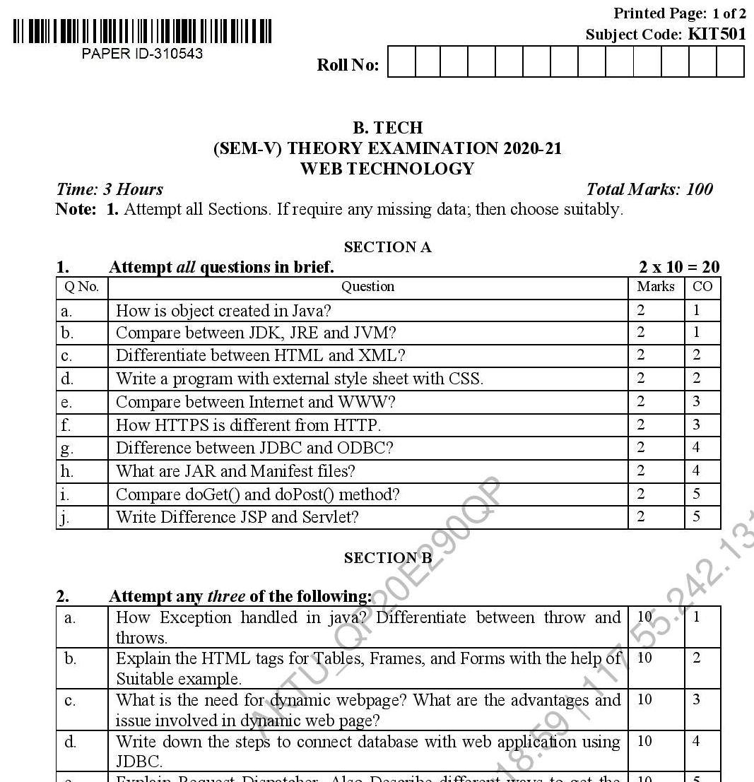
End Semester Question Paper Template

Slide 17
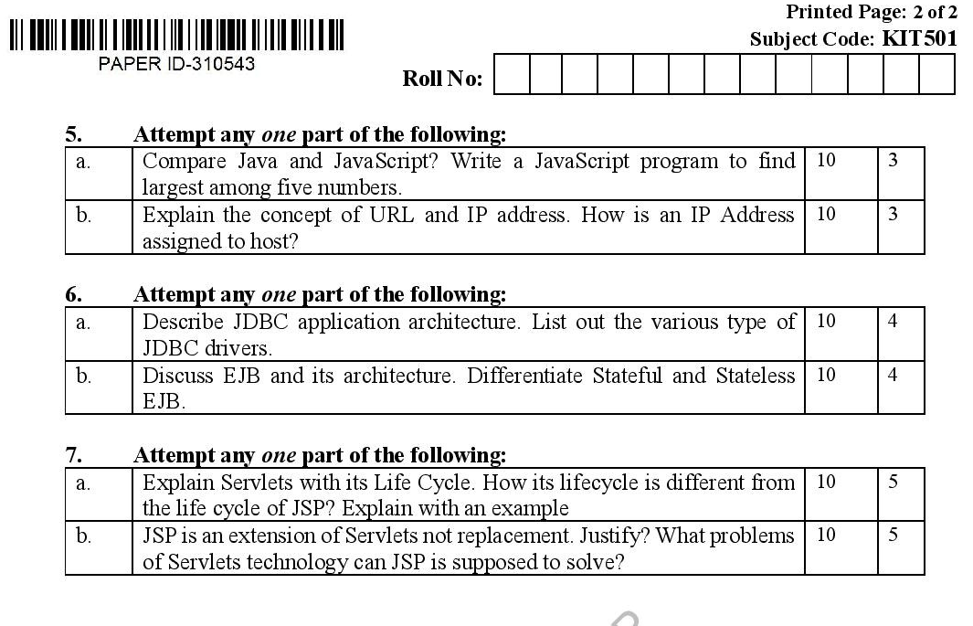
End Semester Question Paper Template

Slide 18
Prerequisites
Prerequisites:
Having knowledge about core java concepts.
Basic knowledge abut the JDBC concepts.
Basic knowledge about the business logic.
Basic knowledge about MVC design pattern
Basic knowledge about RDBMS query.

Slide 19
Brief Introduction to Subject
Advance Java Programming provides libraries to understand the concept of Client-Server architecture for web- based applications.
We can also work with web and application servers such as Apache Tomcat and Glassfish Using these servers, we can understand the working of HTTP protocol.
It provides a set of services, API and protocols, that provides the functionality which is necessary for developing multi-tiered application, web-based application.
There is a number of advance Java frameworks like, Spring, Hibernate, Struts, that enables us to develop secure transaction-based web applications such as banking application, inventory management application.
https://youtu.be/96xF9phMsWA
https://youtu.be/Zopo5C79m2k

Slide 20
Topic Mapping with Course Outcome
Topics | Course outcome
JDBC: Introduction, JDBC Driver, DB Connectivity, Driver Manager, Connection, Statement, Result Set, Prepared Statement Transaction Management, Stored Procedures. Servlet: Servlet Overview, Servlet API, Servlet Interface, Generic Servlet, HTTP Servlet, Servlet Life Cycle. Redirect requests to other resources, Session Tracking, Event and Listener | CO1 CO1 CO2 CO2

Slide 21
Unit 1 Content
JDBC: Introduction
JDBC Driver
DB Connectivity
Driver Manager and Connection classes
Statement, Result Set, Prepared Statement, and interface
Transaction Management and Stored Procedures.
Servlet Overview and Servlet API
Servlet Interface, Generic Servlet and HTTP Servlet with Servlet Life Cycle
Redirect requests to other resources, Session Tracking, Event and Listener

Slide 22
Unit Objective
Objective of Unit 1:
To understand the concepts of JDBC(Java Database Connectivity) driver
To understand the use of various types of SQL command in JDBC connectivity.
To understand the concepts of Statement and PreparedStatement interface
To learn the concepts of stored procedure creation in JDBC.
To understand the concepts of Generic Servlet and HTTP Servlet
To understand the concepts of Redirecting the HTTP request
To understand the concepts of session and event handling.

Slide 23
Objective of the above topics:
To understand the concepts JDBC
To understand the concepts of preparing class of JDBC
To understand the concepts of various types of driver in JDBC
To understand the concepts of Statement and PreparedStatement.
To understand the concepts of transaction management

Slide 24
Java Database Connectivity
How to get started with JDBC

Slide 25
JDBC Definition
JDBC:
Java Database Connectivity
It provides a standard library for Java programs to connect to a database and send it commands using SQL
It generalizes common database access functions into a set of common classes and methods
Abstracts vendor specific details into a code library making the connectivity to multiple databases transparent to user
JDBC API Standardizes:
Way to establish connection to database
Approach to initiating queries
Method to create stored procedures
Data structure of the query result

Slide 26
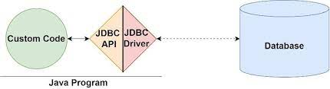
What is JDBC?
JDC acts as an interface or channel between your Java program and databases , so that a programmer can send data from Java code and store it in the database for future use.
Reference : https://www.google.com/url?sa=i&url=https%3A%2F%2Fwww.infoworld.com%2Farticle%2F3388036%2Fwhat-is-jdbc-introduction-to-java-database-connectivity.html&psig=AOvVaw1pj_8eVXEcI75Z8ZGaLVAg&ust=1705997928122000&source=images&cd=vfe&opi=89978449&ved=2ahUKEwiazpvVx_CDAxWHcWwGHd2dDGgQr4kDegQIARBS

Slide 27
JDBC API
Two main packages java.sql and javax.sql
Java.sql contains all core classes required for accessing database
(Part of Java 2 SDK, Standard Edition)
Javax.sql contains optional features in the JDBC 2.0 API
(part of Java 2 SDK, Enterprise Edition)
Javax.sql adds functionality for enterprise applications
DataSources
JNDI
Connection Pooling
Rowsets
Distributed Transactions

Slide 28
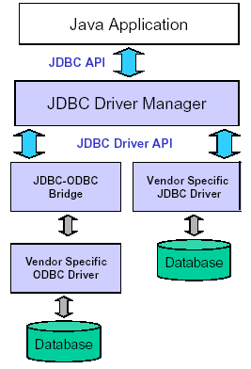
JDBC Architecture
JDBC Consists of two parts:
JDBC API, a purely Java-based API
JDBC Driver Manager, which communicates with vendor-specific drivers that perform the real communication with the database
Translation to the vendor format occurs on the client
No changes needed to the server
Driver (translator) needed on client

Slide 29
JDBC Drivers
JDBC uses drivers to translate generalized JDBC calls into vendor-specific database calls
Drivers exist for most popular databases
Four Classes of JDBC drivers exist
Type I
Type II
Type III
Type IV

Slide 30
JDBC Drivers (Type I: JDBC-ODBC Bridge Driver)
Type I driver provides mapping between JDBC and access API of a database
The access API calls the native API of the database to establish communication
A common Type I driver defines a JDBC to ODBC bridge
ODBC is the database connectivity for databases
JDBC driver translates JDBC calls to corresponding ODBC calls
Thus if ODBC driver exists for a database this bridge can be used to communicate with the database from a Java application
Inefficient and narrow solution
Inefficient, because it goes through multiple layers.
Narrow, since functionality of JDBC code limited to whatever ODBC supports.
Database Specific Protocol
Client
Application
Driver (Type I)
API Protocol
ODBC API
Native API
Database

Slide 31
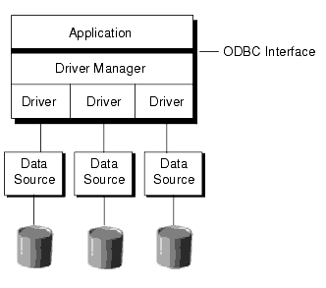
JDBC Open Database Connectivity (ODBC)
A standard database access method developed by the SQL Access group in 1992.
The goal of ODBC is to make it possible to access any data from any application, regardless of which database management system (DBMS) is handling the data.
ODBC manages this by inserting a middle layer, called a database driver , between an application and the DBMS.
The purpose of this layer is to translate the application's data queries into commands that the DBMS understands.
For this to work, both the application and the DBMS must be ODBC-compliant, that is, the application must be capable of issuing ODBC commands and the DBMS must be capable of responding to them.
ODBC Interface

Slide 32
JDBC Drivers (Type II: Native Driver)
Type II driver communicates directly with native API
Type II makes calls directly to the native API calls
More efficient since there is one less layer to contend with (i.e. no ODBC)
It is dependent on the existence of a native API for a database
Client
Application
Driver (Type II)
Native API
Database
API Protocol
Database Specific Protocol

Slide 33
JDBC Drivers (Type III: Network Protocol Driver)
Type III driver make calls to a middleware component running on another server
This communication uses a database independent net protocol
Middleware server then makes calls to the database using database-specific protocol
The program sends JDBC call through the JDBC driver to the middle tier
Middle-tier may use Type I or II JDBC driver to communicate with the database.
Client
Application
Driver (Type III)
Middleware Server
Database
Net Protocol
Database Specific Protocol

Slide 34
JDBC Drivers (Type III: Network Protocol Driver)
Type III driver make calls to a middleware component running on another server
This communication uses a database independent net protocol
Middleware server then makes calls to the database using database-specific protocol
The program sends JDBC call through the JDBC driver to the middle tier
Middle-tier may use Type I or II JDBC driver to communicate with the database.
Client
Application
Driver (Type III)
Middleware Server
Database
Net Protocol
Database Specific Protocol

Slide 35
JDBC Drivers (Type III: Network Protocol Driver)
Type III driver make calls to a middleware component running on another server
This communication uses a database independent net protocol
Middleware server then makes calls to the database using database-specific protocol
The program sends JDBC call through the JDBC driver to the middle tier
Middle-tier may use Type I or II JDBC driver to communicate with the database.
Client
Application
Driver (Type III)
Middleware Server
Database
Net Protocol
Database Specific Protocol

Slide 36
Drivers (Type IV : Thin Driver or Oracle Driver)
Type IV driver is an all-Java driver that is also called a thin driver
It issues requests directly to the database using its native protocol
It can be used directly on platform with a JVM
Most efficient since requests only go through one layer
Simplest to deploy since no additional libraries or middle-ware
Client
Application
Driver (Type IV)
Database Specific Protocol
Database

Slide 37
What we need to Perform JDBC Connection?
Requirements of JDBC Connection:
3
Database:
A database is an organized collection of structured information, or data, typically stored electronically in a computer system. A database is usually controlled by a database management system (DBMS).
Oracle 11g /MySql
1
JDK:
The JDK is the development platform for building Java applications. Install a JDK in your development environment and use it to compile a Java program.
2
IDE:
A Java integrated development environment (IDE) is a software application that provides comprehensive facilities to computer programmers for software development in the Java programming language.
An IDE typically includes a source code editor, build automation tools, and a debugger.
Ecilipse/NetBean IDE
4
.Jar file :
JAR (Java Archive) is a platform-independent file format that aggregates many files into one. Multiple Java applets and their requisite components (.class files, images and sounds) can be bundled in a JAR file.
It is fully extensible.

Slide 38
JDBC Conceptual Components
Driver Manager: Loads database drivers and manages connections between the application and the driver
Driver: Translates API calls into operations for specific database
Connection: Session between application and data source
Statement: SQL statement to perform query or update
Metadata: Information about returned data, database, & driver
Result Set: Logical set of columns and rows of data returned by executing a statement
DriverManager
Creates
Connection
Creates
Statement
Creates
Result Set
Driver
Established
Link to DB
Database

Slide 39
Steps to Connect Java Application with Database
Below are the steps that explains how to connect to Database in Java:
Step 1 – Import the Packages.
Step 2 – Load the drivers using the forName() method .
Step 3 – Register the drivers using DriverManager.
Step 4 – Establish a connection using the Connection class object.
Step 5 – Create a statement.
Step 6 – Execute the query.
Step 7 – Close the connections.

Slide 40
Register the driver class
The forName() method of Predefined Class class is used to register/connect to the Database. This method
is used to dynamically load the driver class.
Syntax of forName() method
public static void forName(String className)throws ClassNotFoundException
How to use this function in code
Class.forName("oracle.jdbc.driver.OracleDriver");

Slide 41
Create the connection object
To Create the connection Object we need to use the Connection Interface &
The getConnection() method of DriverManager class is used to establish connection with the database.
Syntax of getConnection() method
1) public static Connection getConnection(String url)throws SQLException
2) public static Connection getConnection(String url,String name,String password) throws SQLException
How to use this function in code
Connection con =DriverManager.getConnection(“jdbc:Oracle:thin:@localhost:1521:xe”,”Username”,”Password”);

Slide 42
Create the Statement object
The createStatement() method of Connection interface is used to create statement.
The object of statement is responsible to execute queries with the database.
Syntax of createStatement() method
public Statement createStatement()throws SQLException
How to use
Statement stmt=con.createStatement();

Slide 43
Execute the query
The executeQuery() method of Statement interface is used to execute queries to the database.
This method returns the object of ResultSet that can be used to get all the records of a table.
Syntax of executeQuery() method
public ResultSet executeQuery(String sql)throws SQLException
ResultSet rs=stmt.executeQuery("select * from emp");
while(rs.next())
{
System.out.println(rs.getInt(1)+" "+rs.getString(2));
}

Slide 44
Close the connection object
By closing connection object statement and ResultSet will be closed automatically. The close() method of Connection interface is used to close the connection.
Syntax of close() method
public void close()throws SQLException
con.close();

Slide 45
Java Database Connectivity with Oracle
To connect java application with the oracle database, we need to follow 5 following steps.
So we need to know following information for the oracle database:
Driver class: The driver class for the oracle database is oracle.jdbc.driver.OracleDriver.
AP
Connection URL: The connection URL for the oracle10G database is jdbc:oracle:thin:@localhost:1521:xe
Username: The default username for the oracle database is system.
Password: It is the password given by the user at the time of installing the oracle database.
driver
API
database
server
IP address
Service name

Slide 46
Statement interface
The Statement interface provides methods to execute queries with the database. The statement interface is a factory of ResultSet i.e. it provides factory method to get the object of ResultSet.
Methods of Statement interface:
1) public ResultSet executeQuery(String sql): is used to execute SELECT query. It returns the object of ResultSet.
2) public int executeUpdate(String sql): is used to execute specified query, it may be create, drop, insert, update, delete etc.
3) public boolean execute(String sql): is used to execute queries that may return multiple results.
4) public int[] executeBatch(): is used to execute batch of commands.

Slide 47
ResultSet interface
The object of ResultSet maintains a cursor pointing to a row of a table.
Methods of ResultSet interface
1) public boolean next(): | is used to move the cursor to the one row next from the current position.
2) public boolean previous(): | is used to move the cursor to the one row previous from the current position.
3) public boolean first(): | is used to move the cursor to the first row in result set object.
4) public boolean last(): | is used to move the cursor to the last row in result set object.
5) public boolean absolute(int row): | is used to move the cursor to the specified row number in the ResultSet object.
6) public boolean relative(int row): | is used to move the cursor to the relative row number in the ResultSet object, it may be positive or negative.
7) public int getInt(int columnIndex): | is used to return the data of specified column index of the current row as int.
8) public int getInt(String columnName): | is used to return the data of specified column name of the current row as int.
9) public String getString(int columnIndex): | is used to return the data of specified column index of the current row as String.
10) public String getString(String columnName): | is used to return the data of specified column name of the current row as String.

Slide 48
PreparedStatement interface
The PreparedStatement interface is a subinterface of Statement. It is used to execute parameterized query.
Eg:
String sql="insert into emp values(?,?,?)";
(?) for the values. Its value will be set by calling the setter methods of PreparedStatement.
Why use PreparedStatement?
Improves performance: The performance of the application will be faster if you use PreparedStatement interface because query is compiled only once.
The prepareStatement() method of Connection interface is used to return the object of PreparedStatement.
Syntax:
public PreparedStatement prepareStatement(String query)throws SQLException{}

Slide 49
Methods of PreparedStatement interface
Method | Description
public void setInt(int paramIndex, int value) | sets the integer value to the given parameter index.
public void setString(int paramIndex, String value) | sets the String value to the given parameter index.
public void setFloat(int paramIndex, float value) | sets the float value to the given parameter index.
public void setDouble(int paramIndex, double value) | sets the double value to the given parameter index.
public int executeUpdate() | executes the query. It is used for create, drop, insert, update, delete etc.
public ResultSet executeQuery() | executes the select query. It returns an instance of ResultSet.

Slide 50
Pseodu code:
PreparedStatement stmt=con.prepareStatement("update emp set name=? where id=?");
stmt.setString(1,"SS”);//1 specifies the first parameter in the query i.e. name
stmt.setInt(2,001);
int i=stmt.executeUpdate();
System.out.println(i+" records updated");

Slide 51
ResultSetMetaData Interface
metadata means data about data i.e. we can get further information from the data.
ResultSetMetaData interface is useful because it provides methods to get metadata from the ResultSet object.
Methods of ResultSetMetaData
Method | Description
public int getColumnCount()throws SQLException | it returns the total number of columns in the ResultSet object.
public String getColumnName(int index)throws SQLException | it returns the column name of the specified column index.
public String getColumnTypeName(int index)throws SQLException | it returns the column type name for the specified index.
public String getTableName(int index)throws SQLException | it returns the table name for the specified column index.

Slide 52
ResultSetMetaData…………
The getMetaData() method of ResultSet interface returns the object of ResultSetMetaData.
Syntax:
public ResultSetMetaData getMetaData()throws SQLException

Slide 53
To add or import a jar files in your Eclipse IDE
Try it yourself with steps on the right:
1
Right click on your project.
2
Select Build Path.
3
Click on Configure Build Path.
4
Click on Libraries and select Add External JARs.
5
Select the jar file from the required folder.
6
Click and Apply and Ok.

Slide 54
Servlet Syllabus
Servlet: Servlet Overview, Servlet API, Servlet Interface, Generic Servlet, HTTP Servlet, Servlet Life Cycle, Redirect requests to other resources, Session Tracking, Event and Listener.

Slide 55
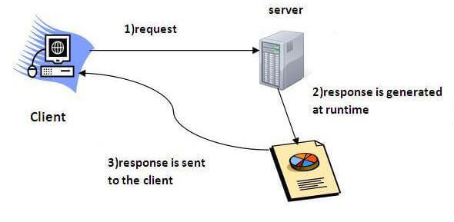
Servlet Overview
Servlet technology is used to create a web application (resides at server side and generates a dynamic web page).
Servlets are the Java programs that run on the Java-enabled web server or application server. They are used to handle the request obtained from the web server, process the request, produce the response, and then send a response back to the web server.
The properties of Servlets are as follows:
Servlets work on the server side.
Servlets are capable of handling complex requests obtained from the web server.
Servlet is an API that provides many interfaces and classes including documentation.
Servlet is an interface that must be implemented for creating any Servlet.
Servlet is a class that extends the capabilities of the servers and responds to the incoming requests. It can respond to any requests.
Servlet is a web component that is deployed on the server to create a dynamic web page.

Slide 56
Servlet Overview………..
Classes that dynamically process requests and construct responses
Dynamically generate html pages in response to requests
May also send data in other forms like XML or serialized Java objects
Run in a servlet container and have access to services that the container provides
In an application processing of each request will normally be done by a different servlet.
e.g. search catalog, check out, confirm order etc.
Client of the servlet can be any of the following
Browser
Applet
Java Application

Slide 57
Advantages of Servlets
The advantages of Servlet are as follows:
Better performance: because it creates a thread for each request, not process.
Portability: because it uses Java language.
Robust: JVM manages Servlets, so we don't need to worry about the memory leak, garbage collection etc.
Secure: because it uses java language.

Slide 58
Servlet Life Cycle
Servlet Container
Create Thread Pool
Thread
Thread
Instantiate servlet
Servlet
Call init ( ) method
Perform Initialization
HTTP Request 1
Call service ( ) method
Allocate request to thread
HTTP Request 2
Call service ( ) method
Allocate request to thread
Perform Service
Shutdown Initiated
Block all further requests Wait for active threads to end
Perform Service
HTTP Response 1
Terminate thread pool
HTTP Response 2
call destroy ( ) method
Perform cleanup
terminate servlet
Servlet destroyed & garbage collected
Container shutdown

Slide 59
Servlet API
Contained in two packages
javax.servlet
javax.servlet.Http
Contains 20 interfaces and 16 classes
Prevalence of interfaces allows servlet implementation to be customized to container

Slide 60
Java Servlets
Javax.servlet package can be extended for use with any application layer protocol
http is the most popularly used protocol
Javax.servlet.http package is extension of the javax.servlet package for http protocol
The Servlet spec allows you to implement separate Java methods implementing each HTTP method in your subclass of HttpServlet.
Override the doGet() and/or doPost() method to provide normal servlet functionality.
Override doPut() or doDelete() if you want to implement these methods.
There's no need to override doOptions() or doTrace().
The superclass handles the HEAD method all on its own.

Slide 61
Javax.servlet Package
Provides the contract between the servlet/web application and the web container
Used for creating protocol independent server applications
Servlet interface defines the core of the entire package
Other interfaces provide additional services to the developer
Contains 12 interfaces
7 interfaces implemented by the package
5 interfaces implemented by the user

Slide 62
Servlet Interfaces
Server implemented interfaces
ServletConfig
ServletContext
ServletRequest
ServletResponse
RequestDispatcher
FilterChain
FilterConfig
User implemented interfaces
Servlet
ServletContextListener
ServletContextAttributeListener
SingleThreadModel
Filter

Slide 63
Servlet Classes
Servlet Classes
GenericServlet
ServletContextEvent
ServletContextAttriubuteEvent
ServletInputStream
ServletOutputStream
ServletRequestWrapper
ServletResponseWrapper
Exception Classes
ServletException
UnavailableException

Slide 64
GenericServlet class
GenericServlet is abstract class that implements servlet interface
Requires implementing the service() method
Servlets normally extend from this class
Methods
LifeCycle Methods
init()
service()
destroy()
Environment Methods
getServletContext()
getInitParameter(…)
getInitParameterNames()

Slide 65
javax.servlet.http
Javax.servlet package provides interfaces and classes to service client requests in protocol independent manner.
Javax.servlet.http package supports http-specific functions.
Several of the classes are derived from the javax.servlet packaage
Some methods from the javax.servlet package are also used
Contains
8 interfaces
7 classes

Slide 66
HTTP Request
HTTP Request | Description
GET | Asks to get the resource at the requested URL.
POST | Asks the server to accept the body info attached. It is like GET request with extra info sent with the request.
HEAD | Asks for only the header part of whatever a GET would return. Just like GET but with no body.
TRACE | Asks for the loopback of the request message, for testing or troubleshooting.
PUT | Says to put the enclosed info (the body) at the requested URL.
DELETE | Says to delete the resource at the requested URL.
OPTIONS | Asks for a list of the HTTP methods to which the thing at the request URL can respond

Slide 67
HttpServlet Class
Extends the Generic Servlet
Inherits the init() and destroy methods()
Overrides the service() method
Service() method
Signature: Protected void service(HttpServletRequest req, HttpServletResponse res)
Forwards the request to the appropriate method
Developer should not normally override this method
The developer needs to implement the methods corresponding to the request
doGet(), doPost(), doHead(), doPut()

Slide 68
HttpServletRequest Interface
Extends ServletRequest
Inherited methods from ServletRequest
getParameterNames()
getParameter(String name)
getParameterValues(String name)
getServerName()
getServerPort()
getRequestDispatcher
New methods defined
getCookies()
getHeader()
getPathInfo()
getContextPath()
getQueryString()

Slide 69
.
HttpServletRequest Interface, cont’d
Extends ServletResponse
Inherited methods from ServletResponse
getoutputStream()
getWriter(String name)
flushBuffer()
setContentType()
New methods
encodeURL(String url)
encodeRedirectURL(String url)
setDateHeader()
setStatus()

Slide 70
Writing a Servlet
Create a servletclass
extend HttpServlet
Implement the doGet() or doPost() method
Both methods accept two parameters
HttpServletRequest
HttpServletResponse
Obtain parameters from HttpServletRequest Interface using
getParameter(String name)
Obtain the writer from the response object
Process input data and generate output (in html form) and write to the writer
Close the writer

Slide 71
Example 1

Slide 72
Example 1 Login Servlet
import javax.servlet.http.*;
import java.io.*;
public class Login extends HttpServlet {
public void doPost(HttpServletRequest request, HttpServletResponse response)
{
// Get the parameter from the request
String username = request.getParameter("username");
// Send the response back to the user
try {
response.setContentType("text/html");
PrintWriter writer = response.getWriter();
writer.println("<html><body>");
writer.println("Thank you, " + username + ". You are now logged into the system.");
writer.println("</body></html>");
writer.close();
} catch (Exception e) {
e.printStackTrace();
}
}
}

Slide 73
Example 1 Login.html
<!DOCTYPE HTML PUBLIC "-//W3C//DTD HTML 4.01 Transitional//EN">
<html>
<head>
<title>Login</title>
</head>
<body>
<h1>Login</h1>
Please enter your username and password
<form action="servlet/niet.servlets.Login" method="POST">
<p><input type="text" name="username" length="40">
<p><input type="password" name="password" length="40">
<p><input type="submit" value="Submit">
</form>
</body>
</html>

Slide 74
Example 1 web.xml
<?xml version="1.0" encoding="ISO-8859-1"?>
<!DOCTYPE web-app
PUBLIC "-//Sun Microsystems, Inc.//DTD Web Application 2.3//EN"
"http://java.sun.com/dtd/web-app_2_3.dtd">
<web-app>
<display-name>Login Servlet</display-name>
<servlet>
<servlet-name>Login</servlet-name>
<servlet-class>niet.servlets.Login</servlet-class>
</servlet>
<servlet-mapping>
<servlet-name>Login</servlet-name>
<url-pattern>/Login</url-pattern>
</servlet-mapping>
</web-app>

Slide 75
Example 1 Login Deployment
Compiling
Makefile contains all the scripts for compiling and deployment of the servlet
Needs to be modified for any give application
Commands
make shutdown: shuts down the tomcat server
make clean: cleans up the current setup for the application
make all: compiles code, creates war file and deploys war file on server
make startup: starts the server again
Running the servlet
http://localhost:8080/login/login.html

Slide 76
SendRedirect in servlet
The sendRedirect() method of HttpServletResponse interface can be used to redirect response to another resource, it may be servlet, jsp or html file.
It accepts relative as well as absolute URL.
It works at client side because it uses the url bar of the browser to make another request. So, it can work inside and outside the server.
Syntax of sendRedirect() method
public void sendRedirect(String URL)throws IOException;
Eg:
response.sendRedirect("http://www.niet.co.in");

Slide 77
Difference between forward() and sendRedirect() method
forward() method | sendRedirect() method
The forward() method works at server side. | The sendRedirect() method works at client side.
It sends the same request and response objects to another servlet. | It always sends a new request.
It can work within the server only. | It can be used within and outside the server.
Example: request.getRequestDispacher("servlet2").forward(request,response); | Example: response.sendRedirect("servlet2");

Slide 78
Session Tracking in Servlet
Session simply means a particular interval of time.
Session Tracking is a way to maintain state (data) of an user.
Http protocol is a stateless so we need to maintain state using session tracking techniques
Each time user requests to the server, server treats the request as the new request
So we need to maintain the state of an user to recognize to particular user.

Slide 79
Cookies In Servlet
A cookie is a small piece of information that is persisted between the multiple client requests.
The cookie class provides an easy way for servlet to read, create, and manipulate HTTP-style cookies, which allows servlets to store small amount of data.
A servlet uses the getCookies() method to retrieve cookies as request.
The addCookie() method sends a new cookie to the browser

Slide 80
Example
<cookie.html>
<html> <body> <center> <h1>Cookies Example in Java</h1> <form action=“"http://localhost:8080/cookies/co” method="Post"> First name: <input type="text" name="fname"> Last name: <input type="text" name="lname"> <input type="submit“ value="SUBMIT"> </form> </center> </body> </html

Slide 81
Cookies Example(cont..)
<AddCookie.java>
import javax.servlet.*; import javax.servlet.http.*; import java.io.*; public class AddCookie extends HttpServlet { public void doPost(HttpServletRequest req,HttpServletResponse res) throws ServletException,IOException {

Slide 82
Cookies Example(cont..)
<AddCookie.java>(cont..)
String fname=req.getParameter("fname"); String lname=req.getParameter("lname"); Cookie f=new Cookie("first_name",fname); Cookie l=new Cookie("last_name",lname); res.addCookie(f); res.addCookie(l); res.sendRedirect("http://localhost:8080/cookies/st”); } }

Slide 83
Cookies Example(cont..)
<GetCookie.java>
import javax.servlet.*; import javax.servlet.http.*; import java.io.*; public class GetCookie extends HttpServlet { public void doGet(HttpServletRequest req,HttpServletResponse res) throws ServletException,IOException { PrintWriter out=res.getWriter();
out.println("<h1>"); Cookie[] c=req.getCookies(); for(Cookie k:c) { out.println(k.getValue()); }
out.println("</h1>"); } }

Slide 84
Session Tracking using HTTPSession interface
The HttpServletRequest interface provides two methods to get the object of HttpSession
public HttpSession getSession()
public HttpSession getSession(boolean create)

Slide 85
Example of Session Tracking using HTTPSession interface
<Index.html>
<form action="servlet1">
Name:<input type="text" name="userName"/><br/>
<input type="submit" value="go"/>
</form>

Slide 86
Example of Session Tracking using HTTPSession interface
<FirstServlet.java>
import java.io.*;
import javax.servlet.*;
import javax.servlet.http.*;
public class FirstServlet extends HttpServlet {
public void doGet(HttpServletRequest request, HttpServletResponse response){
try{
response.setContentType("text/html");
PrintWriter out = response.getWriter();
String s1=request.getParameter("userName");
out.print("Welcome "+s1);

Slide 87
Example of Session Tracking using HTTPSession interface(cont..)
<FirstServlet.java>
HttpSession session=request.getSession();
session.setAttribute(“First",s1);
out.print("<a href='servlet2'>visit</a>");
out.close();
}catch(Exception e){System.out.println(e);}
}
}

Slide 88
Example of Session Tracking using HTTPSession interface(cont..)
<SecondServlet.java>
import java.io.*;
import javax.servlet.*;
import javax.servlet.http.*;
public class SecondServlet extends HttpServlet {
public void doGet(HttpServletRequest request, HttpServletResponse response)
try{
PrintWriter out = response.getWriter();
HttpSession session=request.getSession(false);

Slide 89
Example of Session Tracking using HTTPSession interface(cont..)
<SecondServlet.java>
String n=(String)session.getAttribute(“First");
out.print("Hello "+n);
out.close();
}catch(Exception e){System.out.println(e);}
}
}

Slide 90
Event and Listener in Servlet
Events are basically occurrence of something. Changing the state of an object
We can perform some important tasks at the occurrence of these exceptions, such as counting total and current logged-in users, creating tables of the database at time of deploying the project, creating database connection object

Slide 91
Event Class in Servlet
ServletRequestEvent
ServletContextEvent
ServletRequestAttributeEvent
ServletContextAttributeEvent
HttpSessionEvent
HttpSessionBindingEvent

Slide 92
Event Interface in Servlet
ServletRequestListener
ServletRequestAttributeListener
ServletContextListener
ServletContextAttributeListener
HttpSessionListener
HttpSessionAttributeListener
HttpSessionBindingListener
HttpSessionActivationListener

Slide 93
ServletContextEvent and ServletContextListener
The ServletContextEvent is notified when web application is deployed on the server
There is only one constructor defined in the ServletContextEvent class.
The web container creates the instance of ServletContextEvent after the ServletContext instance.

Slide 94
Example of ServletContextEvent and ServletContextListener
index.html
<a href="servlet1">fetch records</a>

Slide 95
Example of ServletContextEvent and ServletContextListener(Cont..)
MyListener.java
import javax.servlet.*;
import java.sql.*;
public class MyListener implements ServletContextListener{
public void contextInitialized(ServletContextEvent event) {
try{
Class.forName("oracle.jdbc.driver.OracleDriver");
Connection con=DriverManager.getConnection(
"jdbc:oracle:thin:@localhost:1521:xe","system","oracle");
//storing connection object as an attribute in ServletContext
ServletContext ctx=event.getServletContext();
ctx.setAttribute("mycon", con);
}catch(Exception e){e.printStackTrace();}
}
public void contextDestroyed(ServletContextEvent arg0) {}

Slide 96
Example of ServletContextEvent and ServletContextListener(Cont..)
MyListener.java
import java.io.*;
import javax.servlet.*;
import javax.servlet.http.*;
import java.sql.*;
public class FetchData extends HttpServlet {
public void doGet(HttpServletRequest request, HttpServletResponse response)
throws ServletException, IOException {
response.setContentType("text/html");
PrintWriter out = response.getWriter();
try{
//Retrieving connection object from ServletContext object
ServletContext ctx=getServletContext();
Connection con=(Connection)ctx.getAttribute("mycon");
//

Slide 97
Example of ServletContextEvent and ServletContextListener(Cont..)
retieving data from emp32 table
PreparedStatement ps=con.prepareStatement("select * from emp32",
ResultSet.TYPE_SCROLL_SENSITIVE,ResultSet.CONCUR_UPDATABLE);
ResultSet rs=ps.executeQuery();
while(rs.next()){
out.print("<br>"+rs.getString(1)+" "+rs.getString(2));
}
con.close();
}catch(Exception e){e.printStackTrace();}
out.close();
}
}

Slide 98
Previous Topics: Recap
The previous topic was mainly focused on the concepts of Java Servlet API and its life cycle.
It was focused on the various types of classes and interfaces
It was also focused on the concept of redirecting HTTP request
It was also focused on servlet event and listener classes with its implementation

Slide 99
Daily Quiz(cont..)
Which middleware services are provided by EJB?
A. Security
B. Transaction Management
C. Both A & B
D. None of the above
What represents a persistent global data from the database?
A. Entity Bean
B. Session Bean
C. Both A & B
D. None of the above

Slide 100
Daily Quiz(cont..)
Which of the following manages a list of database drivers in JDBC?
A - DriverManager
B - JDBC driver
C - Connection
D - Statement
Which of the following is true about JDBC architecture?
A - JDBC API layer provides the application-to- JDBC Manager connection.
B - JDBC Driver API layer supports the JDBC Manager-to-Driver Connection.
C - Both of the above.
D - None of the above.

Slide 101
Daily Quiz
How constructor can be used for a servlet? a) Initialization b) Constructor function c) Initialization and Constructor function d) Setup() method
Can servlet class declare constructor with ServletConfig object as an argument? a) True b) False
How is the dynamic interception of requests and responses to transform the information done? a) servlet container b) servlet config c) servlet context d) servlet filter

Slide 102
Daily Quiz(cont..)
When init() method of servlet gets called?
A - The init() method is called when the servlet is first created.
B - The init() method is called whenever the servlet is invoked.
C - Both of the above.
D - None of the above.
What is javax.servlet.http.HttpServlet?
A - interface
B - abstract class
C - concreate class
D - None of the above.

Slide 103
Daily Quiz(cont..)
Which of the following code is used to get session in servlet?
A - request.getSession()
B - response.getSession()
C - new Session()
D - None of the above.
Which of the following code retrieves the request header?
A - Header.getHeaderName(headerName)
B - response.getHeader(headerName)()
C - request.getHeader(headerName)
D - None of the above.

Slide 104
Daily Quiz(cont..)
Which of the following code retrieves the fully qualified name of the client making this request?
A - request.getRemoteHost()
B - response.getRemoteHost()
C - Header.getRemoteHost()
D - None of the above.
Which of the following code can be used to send an error response to the client using the specified status code and clearing the buffer.
A - request.sendError(statusCode)
B - response.sendError(statusCode)
C - header.sendError(statusCode)
D - None of the above.

Slide 105
Daily Quiz(cont..)
Which of the following code is used to get session in servlet?
A - request.getSession()
B - response.getSession()
C - new Session()
D - None of the above.
Which of the following code is used to get session id of a HTTP Session object in servlets?
A - session.getSessionId()
B - session.getId()
C - session.getActiveId()
D - None of the above.

Slide 106
Daily Quiz(cont..)
Three methods of Servlet interface init(), service() and destroy()
i) True
ii) False
Cookie is a piece of information that stored on server ?
i) True
ii) False
Session is series of request for a single user.
i) True
ii) False
init() method in servlet life cycle call again and again
i) True
ii) False

Slide 107
Daily Quiz(cont..)
In CGI based application for every request server create a child process
i) True
ii) False
Servlet Container is also called Servlet Manager .
i) True
ii) False

Slide 108
Weekly Assignment
Discuss the servlet life cycle and its API in details
Write a program to implement handling HTTP post request.
Write a program to implement cookies in servlet
Write a program that implement PreparedStatement in JDBC.
Write a program to implement joining two table in JDBC

Slide 109
Youtube & NPTEL Video Links and Online Courses Details
https://www.youtube.com/watch?v=utANrHfAh28
https://www.digimat.in/nptel/courses/video/106105191/L01.html
https://www.youtube.com/watch?v=y_YxwyYRJek
https://www.youtube.com/watch?v=0SFVFe6a
https://www.youtube.com/watch?v=ajhWv31oN1k KK8
https://www.youtube.com/watch?v=v5vLuCBv8vg
https://www.youtube.com/watch?v=5ammL5KU4mo

Slide 110
Unit 1 MCQ s
1. The JDBC API has always supported persistent storage of objects defined in the Java programming language through the methods getObject and setObject.
a. True
b. False
2. The ACID properties does not describes the transaction management well.
a.True
b. False
3. The ResultSet.next method is used to move to the next row of the ResultSet, making it the current row. a. True
b. False

Slide 111
Unit 1 MCQ s(cont..)
4. How many steps are used to connect any java application using JDBC?
a. 5
b. 4
c. 3
d. 6
5. In the following JDBC drivers which is known as fully java driver? a. Native-API driver
b. Network Protocol driver
c. Thin driver
d. Both B & C

Slide 112
Unit 1 MCQ s(cont..)
6. Which models do the JDBC API support for the database access?
a. Two-tier models
b. Three-tier models
c. Both A & B
d. None of the above
7. Which of the following JDBC drivers is known as a partially java driver?
a. JDBC-ODBC bridge driver
b. Native-API driver
c. Network Protocol driver
d. Thin driver

Slide 113
Unit 1 MCQ s(cont..)
8. How many types of JDBC drivers are available? a. 3
b. 4
c. 2
d. 5
9. How many JDBC product components does the Java software provides?
a. 3
b. 2
c. 4
d. 5

Slide 114
Unit 1 MCQ s(cont..)
10. Which services are provided to EJB components by the EJB container? a. Transaction support
b. Persistence support
c. Naming support
d. All mentioned above
11. Which session bean maintain their state between client invocations but are not required to maintain their state across server crashes or shutdowns? a. Stateful Session Bean
b. Stateless Session Bean
c. Singleton Session Bean
d. None of the above

Slide 115
Unit 1 MCQ s(cont..)
18. Which of the following is used to call stored procedure?
a.Statement b.PreparedStatement c.CallableStatment d. CalledStatement
19. Which of the following is method of JDBC batch process? a. setBatch() b. deleteBatch() c. removeBatch() d. addBatch()

Slide 116
Unit 1 MCQ s(cont..)
8. Which method is used to send the same request and response objects to another servlet in RequestDispacher ?
a. forward()
b. sendRedirect()
c. Both A & B
d. None of the above
9. Which packages represent interfaces and classes for servlet API?
a. javax.servlet
b. javax.servlet.http
c. Both A & B
d. None of the above

Slide 117
Unit 1 MCQ s(cont..)
10. Which HTTP Request method is non-idempotent
a. GET
b. POST
c. BOTH A & B
d. None of the above
11. Which object is created by the web container at time of deploying the project?
a. ServletConfig
b. ServletContext
c. Both A & B
d. None of the above

Slide 118
Unit 1 MCQ s(cont..)
12. In HTTP Request what asks for the loopback of the request message, for testing or for troubleshooting? a. PUT
b. OPTIONS
c. DELETE
d. TRACE
13. Which one of the following scopes does the attribute in servlet is an object that can be set, get or removed? a. session scope
b. request scope
c. application scope
d. All mentioned above

Slide 119
Glossary Questions
The------------interface is used to call stored procedure? a) Statement b) PreparedStatement c) CallableStatment d) CalledStatement
The-----------method is used to rollback a JDBC transaction? a) rollback() b) rollforward() c) deleteTransaction() d) RemoveTransaction()

Slide 120
Glossary Questions
3. EJB stands for---------------
A - Enterprise J2EE Bean
B - Enterprise Java Bean
C - Enterprise Java oBject
D - Entity Java object
4. --------------interface session bean is used in EJB.
a) EJBRemote
b) EJBHome
c) Remote

Slide 121
Glossary Questions
The Java __________ specification defines an application programming interface for communication between the Web server and the application program. a) Servlet b) Server c) Program
The --------------- application servers do not provide built in support for servlets. a) Tomcat server b) Glassfish c) Jboss

Slide 122
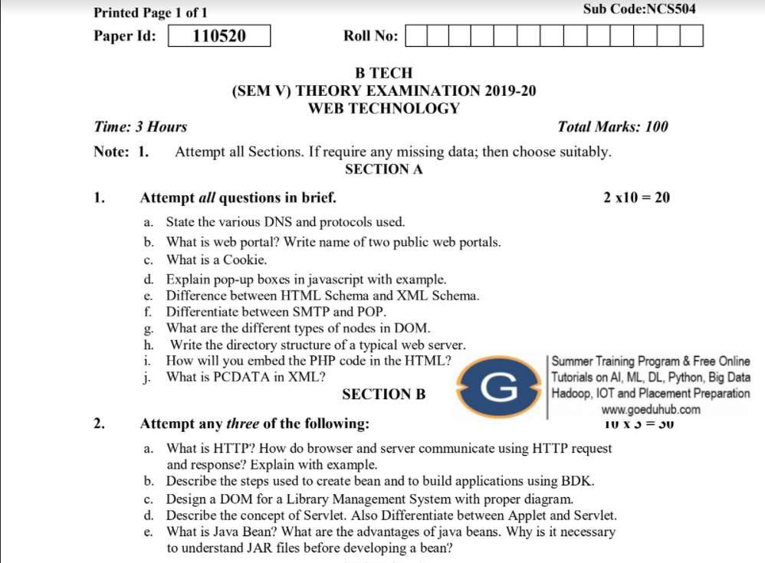
Old Question Paper
2019-20
https://drive.google.com/file/d/1eLOPdCx5cPPU08FiaBH3QiQnHTX_9xhk/view

Slide 123
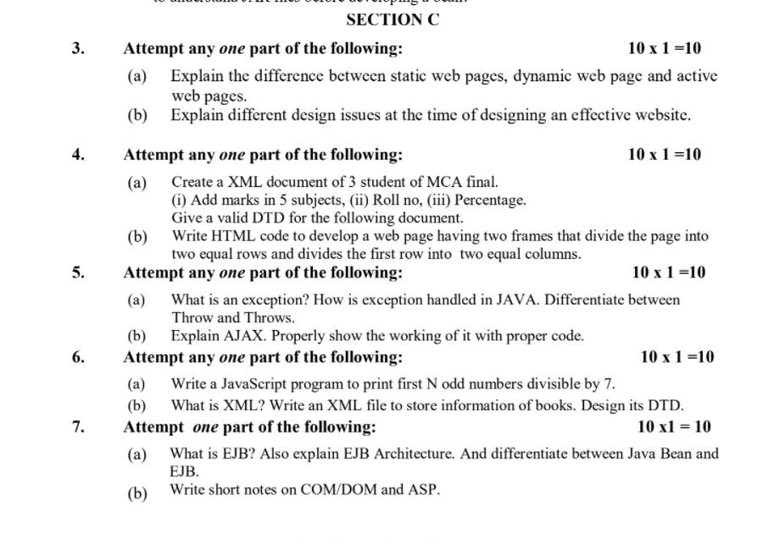
Old Question Paper(cont..)

Slide 124
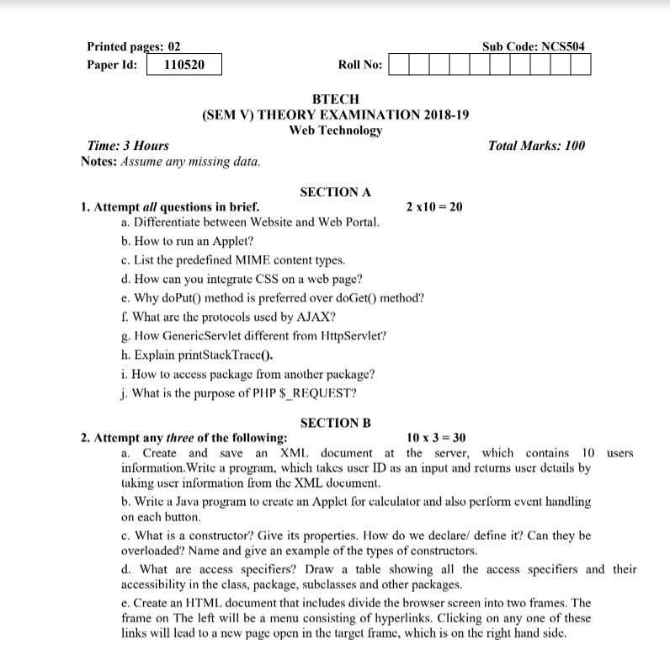
Old Question Paper(cont..)
2018-19
https://drive.google.com/file/d/1FsvkCgeo7sf1q4WRx7vh7A1fRNkJ0_2q/view

Slide 125
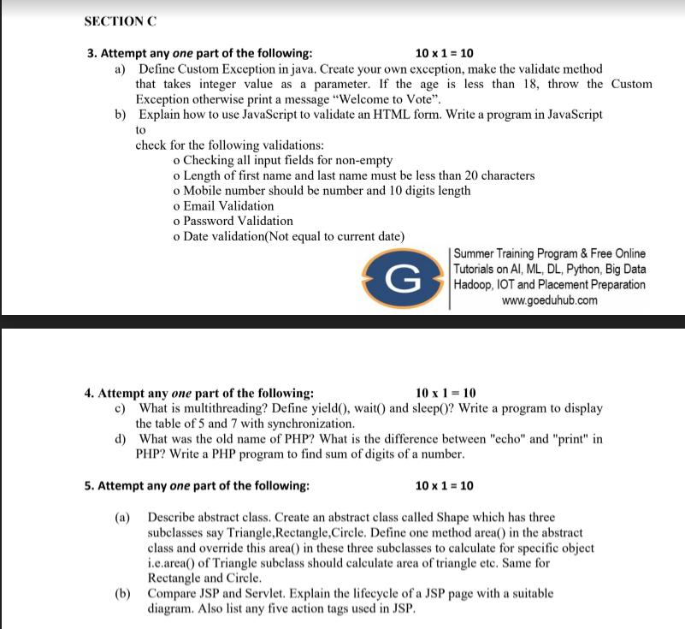
Old Question Paper(cont..)

Slide 126
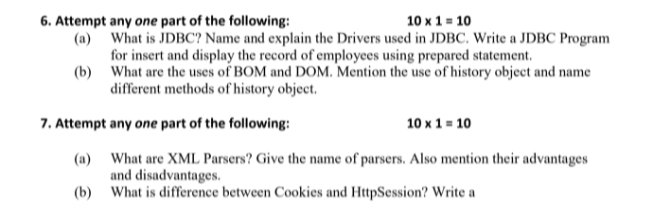
Old Question Paper(cont..)

Slide 127
Expected Questions for University Exam
Discuss various types of driver used in JDBC details
Write a program to inserting multiple rows in employee table by using PreparedStatement interface
Discuss about Servlet API in details descriptions
Explain the life cycle of servlet in details
Write a program that implement Session tracking by usin HTTPSession method.
Explain the process to handle the exception on your JSP page
What is purpose to use the web container in servlet.
Explain the reason to use sendRedirect() method in JSP with the help of suitable example.

Slide 128
References
Bhave, “Programming with Java”, Pearson Education.
Naughton, Schildt, “The Complete Reference JAVA2”, TMH.
Deitel, “Java for programmers”, Pearson Education.
Tanveer Alam, Internet and Java Programming, Khanna Publishing House.
Balagurusamy E, “Programming in JAVA”, TMH

Slide 129
Recap of Unit 1
Discussed Java Database Connectivity in details
Discussed about the parameterized query statement
Design and implent of stored procedure using JDBC
Explain the servlet overview and its architecture
Design and implementation of HTTP get and post request
Discussed about various types session handling in servlet
Discuss about the life cycle of servlet and jsp with their implementation

Slide 130
Thank You

